Slide 1

Comp90042
Workshop
Week 8
9 May

Slide 2
Table of Contents
Language theory
Parsing

Slide 3
Regular language
What are regular grammar and regular language? How are they different?
Language: set of acceptable strings (e.g., sentences)
Grammar: a generative description of a language
Regular language: language accepted by regular expression w
Regular grammar: a formal grammar defined by a set of productions rules
  A → xB,
  A → x
  A → ε
  where A and B are non-terminals, x is a terminal and ε is the empty string.
Notes:
A language is a set of acceptable strings and a grammar is a generative description of a language.
Regular language is a formal language that can be expressed using a regular expression.
Regular grammar is a formal grammar defined by a set of productions rules in the form of A->xB, A->x and A->epsilon, where A and B are non-terminals, x is a terminal and epsilon is the empty string.
A language is regular if and only if it can be generated by a regular grammar.

Slide 4
Regular grammar example
Rules:
  S → A
  A → a A
  A → ε
Example strings?
  a, aa, aaa, aaa.
Regular expression?
  (a)*
Notes:
For example: A simple regular grammar
– Rules: S! A, A! a A, A!
– S is the start symbol
– It will generate words such as a, aa, aaa, aaa.
– The set of words generated by this regular grammar is a regular language.
– This regular language can also be expressed in regular expression (a)*.

Slide 5

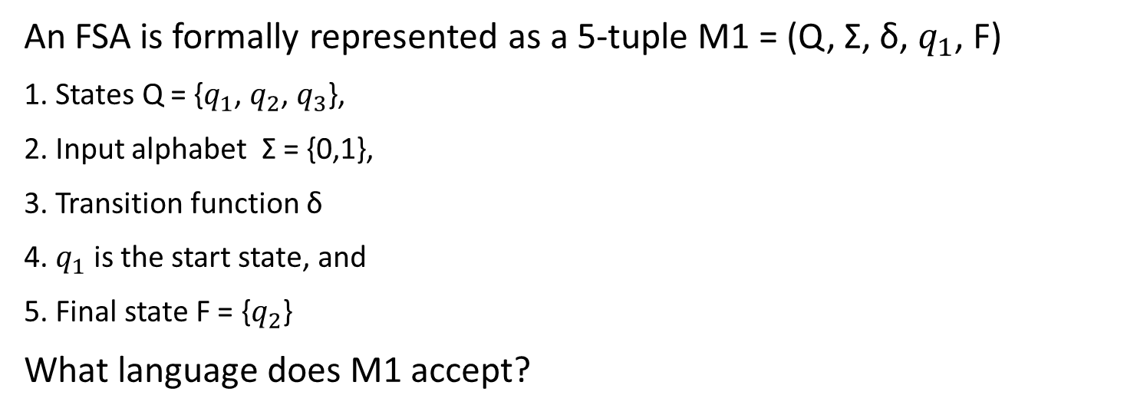
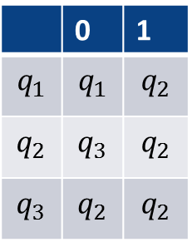
Finite State Automata
An FSA is formally represented as a 5-tuple M1 = (Q, Σ, δ, $q_{1}$, F)
1. States Q = {$q_{1}$, $q_{2}$, $q_{3}$},
2. Input alphabet Σ = {0,1},
3. Transition function δ
4. $q_{1}$ is the start state, and
5. Final state F = {$q_{2}$}
What language does M1 accept?
Transition function
 | 0 | 1
$$q_{1}$$ | $$q_{1}$$ | $$q_{2}$$
$$q_{2}$$ | $$q_{3}$$ | $$q_{2}$$
$$q_{3}$$ | $$q_{2}$$ | $$q_{2}$$
Notes:
Regular languages can also be represented as FSA

Slide 6
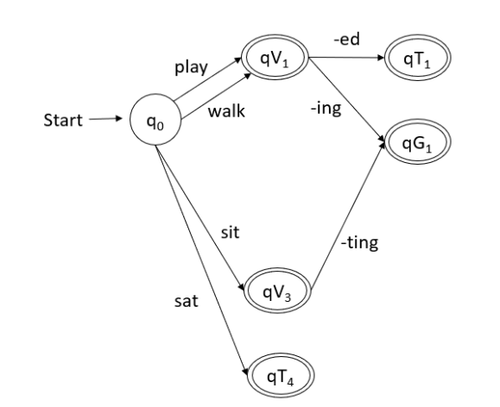
Example: Word Morphology
Draw a Finite State Acceptor (FSA) for word morphology to show the possible derivations from root forms using the words: play, played, playing; walk, walked, walking; sit, sat, sitting.
Notes:
There are many correct answers. Below is one. From the start state q0, we have three words in base form and one word in paste tense. For play and walk, we can apply trainsition function, add- ed to make it a paste tense, and add –ing to make it a gerund

Slide 7
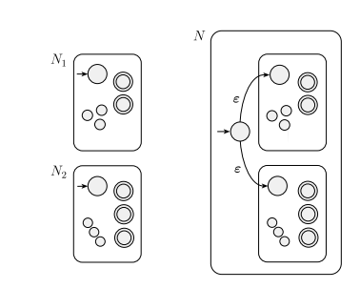
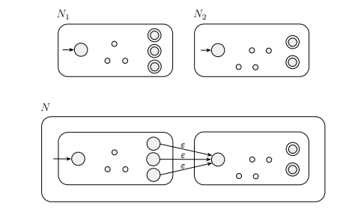
Properties of regular languages
Regular languages are closed under union, intersection and concatenation. What does it mean? Why is it important?
union
concatenation
If L1 and L2 are two regular languages, then the union, intersection and concatenation of L1 and L2 are also regular languages
NLP problems can be factored into small simple parts,
we can develop regular languages for each part,
and combine them into a complex system to handle the NLP problems.
Notes:
This means that if L1 and L2 are two regular languages, then L1 [ L2, L1
\ L2, and the language strings that are the concatenation of L1 and L2 are
also regular languages.
This closure property allows us to apply operations on regular languages
to produce a regular language.
This allows for NLP problems to be factored into small simple parts, such
that we can develop regular languages for each part, and combine them
into a complex system to handle the NLP problems. This is particularly
relevant for transducers and the composition operation, which are used
in many NLP pipelines.

Slide 8
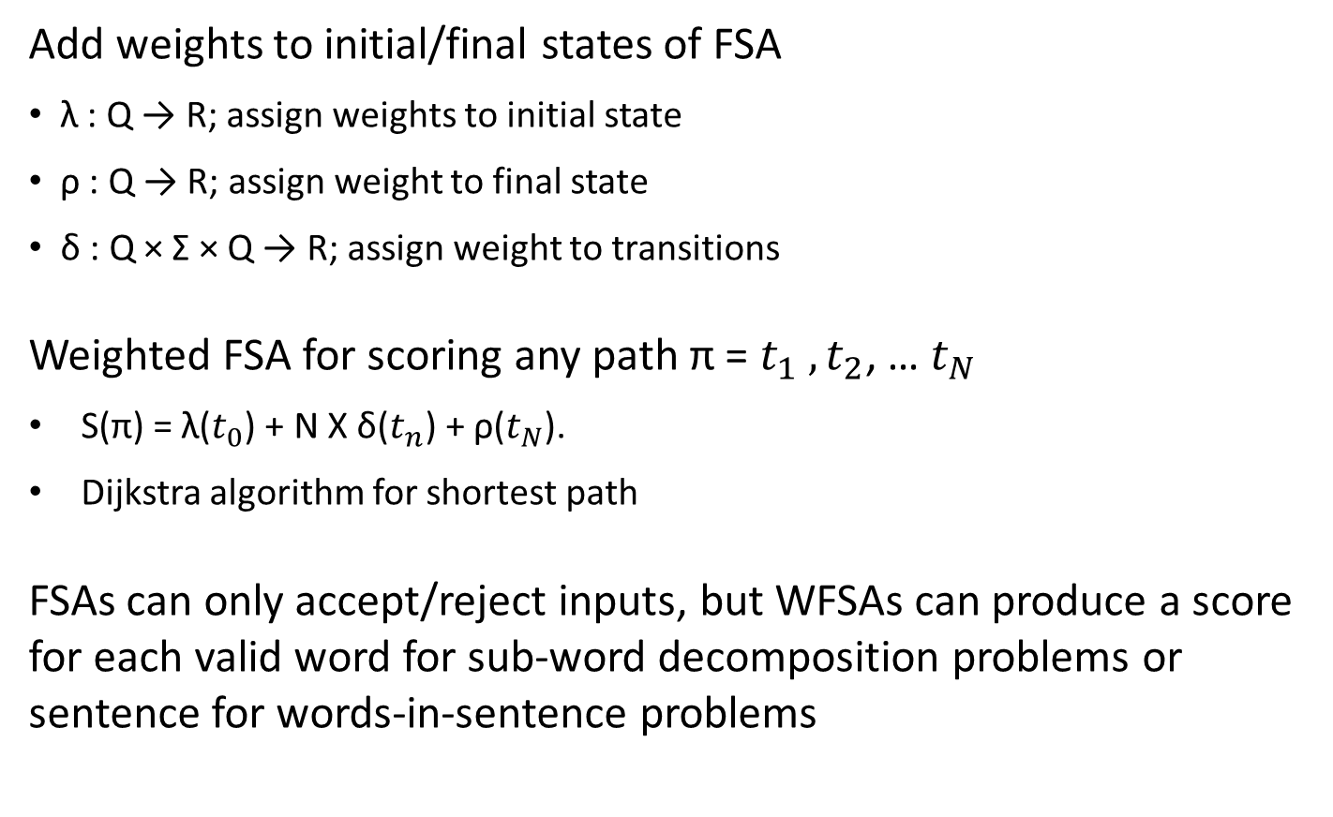
Weighted FSA
Add weights to initial/final states of FSA
λ : Q → R; assign weights to initial state
ρ : Q → R; assign weight to final state
δ : Q × Σ × Q → R; assign weight to transitions
Weighted FSA for scoring any path π = $t_{1} ,t_{2}$, … $t_{N}$
S(π) = λ($t_{0}$) + N X δ($t_{n}$) + ρ($t_{N}$).
Dijkstra algorithm for shortest path
FSAs can only accept/reject inputs, but WFSAs can produce a score for each valid word for sub-word decomposition problems or sentence for words-in-sentence problems
Notes:
What are Weighted Finite State Acceptors (WFSAs)? When and why are they useful?
WFSAs are generalizations of FSAs, with each path assigned a score, computed
from the transitions, the initial state, and the final state. The total
score for any path is equal to the sum of the scores of the initial state, the
transitions, and the final state.
WFSAs can produce a score for each valid word for sub-word decomposition
problems or sentence for words-in-sentence problems, while FSAs
have no way to express preferences among technically valid words or sentences.
For example, WFSAs can assign scores to all strings of characters forming
words, so that spelling mistakes, new words, or strange-but-acceptable
words can still be handled.
The same argument holds for sequences of words forming sentences. Clearly
some word sequences are gibberish, but being able to provide a numerical
score can help in many applications, like how LMs can be used in
sentence generation, speech recognition, OCR, translation, etc.

Slide 9
Context-free grammar
  A context-free grammar is a 4-tuple G = (V, Σ, R, S)
  V, a set of non-terminal symbols (or variables)
  Σ, a set of terminal symbols (disjoint from V)
  R a set of rules in the form A → β, where A is a non-terminal, β is a string of variables and terminals
  S ∈ V, the start variable
  Context free languages are more expressive than regular languages.

Slide 10
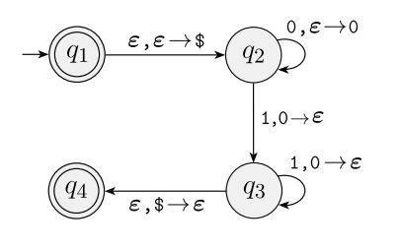
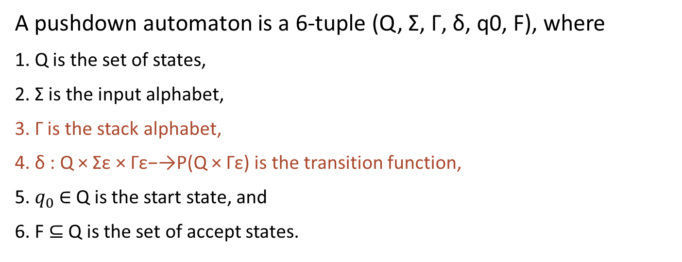
Pushdown automata
A pushdown automaton is a 6-tuple (Q, Σ, Γ, δ, q0, F), where
1. Q is the set of states,
2. Σ is the input alphabet,
3. Γ is the stack alphabet,
4. δ : Q × Σε × Γε−→P(Q × Γε) is the transition function,
5. $q_{0}$∈ Q is the start state, and
6. F ⊆ Q is the set of accept states.

Slide 11
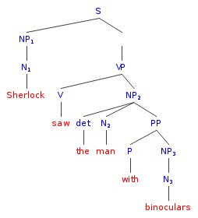
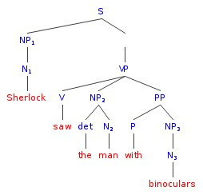
Parsing
Parsing in general is the process of identifying the structure(s) of a sentence, according to a grammar of the language.
Example parse trees

Slide 12
Parsing
(a) What changes need to be made to this CFG to make it suitable for CYK parsing?
S -> NP VP
VP -> V NP | V NP PP
PP -> P NP
V -> "saw" | "walked"
NP -> "John" | "Bob" | Det N | Det N PP
Det -> "a" | "an" | "the" | "my"
N -> "man" | "cat" | "telescope" | "park"
P -> "on" | "by" | "with"
Chomsky Normal Form: Each rule consists of
  A -> B C
  A -> a
VP -> V X ​
X -> NP PP
NP -> Det Y
Y -> N PP
Notes:
For CYK parsing, a grammar needs to be written in Chomsky Normal
Form, where each rule consists of either:
– a (single) non-terminal which re-writes as a single terminal, or
– a (single) non-terminal which re-writes as exactly two non-terminals
Here, we have two rules where a non-terminal re-writes as three non-terminals
(VP -> V NP PP and NP -> Det N PP); we remove these
rules and replace them with the following:
VP -> V X
X -> NP PP
NP -> Det Y
Y -> N PP

Slide 13
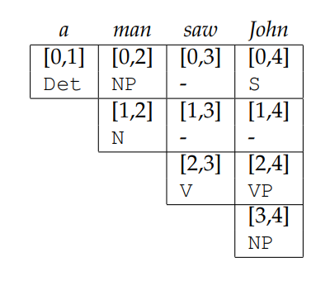
CYK Example 1
S -> NP VP ​
VP -> V NP | V X
PP -> P NP ​
V -> "saw" | "walked" ​
NP -> "John" | "Bob" | Det N | Det Y
Det -> "a" | "an" | "the" | "my"​
N -> "man" | "cat" | "telescope" | "park" ​
P -> "on" | "by" | "with"​
​X -> NP PP
Y -> N PP

Slide 14
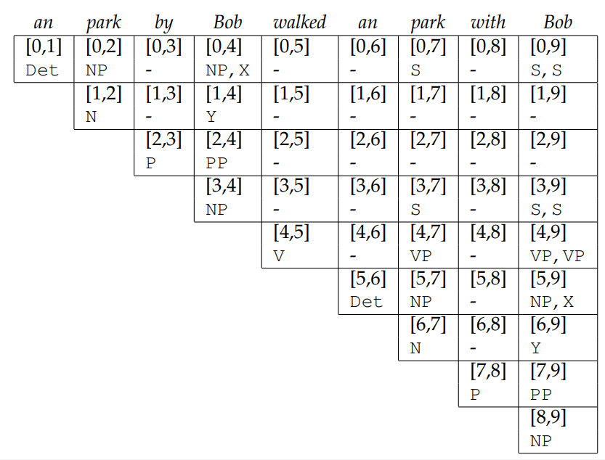
CYK example 2
S -> NP VP ​
VP -> V NP | V X
PP -> P NP ​
V -> "saw" | "walked" ​
NP -> "John" | "Bob" | Det N | Det Y
Det -> "a" | "an" | "the" | "my"​
N -> "man" | "cat" | "telescope" | "park" ​
P -> "on" | "by" | "with"​
​X -> NP PP
Y -> N PP

Slide 15
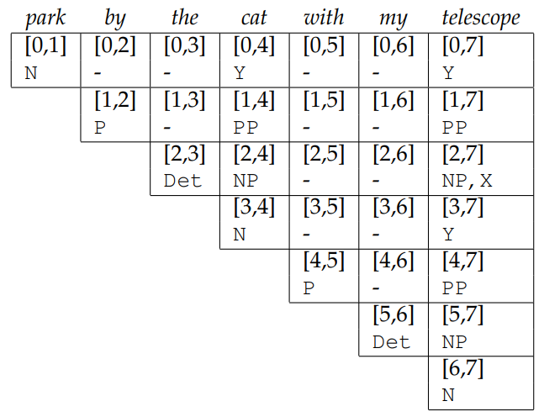
CYK example 3
S -> NP VP ​
VP -> V NP | V X
PP -> P NP ​
V -> "saw" | "walked" ​
NP -> "John" | "Bob" | Det N | Det Y
Det -> "a" | "an" | "the" | "my"​
N -> "man" | "cat" | "telescope" | "park" ​
P -> "on" | "by" | "with"​
​X -> NP PP
Y -> N PP

Slide 16
Takeaways
Regular languages:
  Regular Grammar
  Finite state acceptors (FSA)
  Weighted finite state acceptors (WFSA)
Context Free Languages
  Context Free Grammar
  CYK algorithm for parsing

